Slide 1
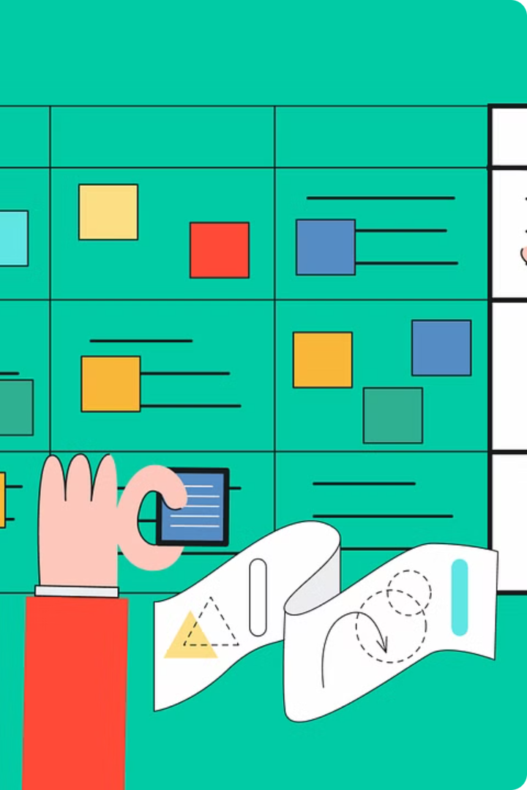


Introduction to User Stories
User stories are a powerful tool for capturing user requirements and guiding software development. They focus on the user's perspective, describing the value they'll receive from a feature or functionality.
by Manish

Slide 2
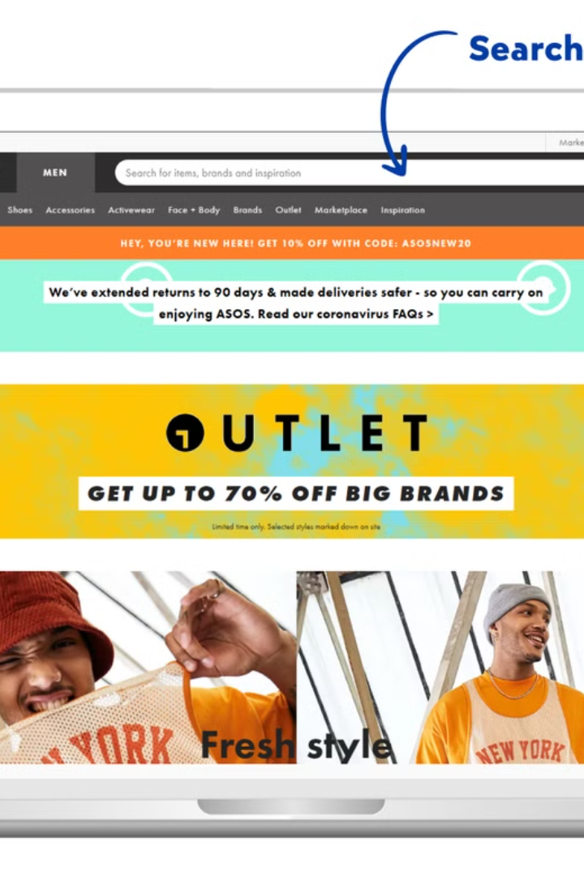
User Story Example 1
As a customer, I want to be able to search for products on the website, so that I can easily find the items I'm looking for. An effective search function allows me to quickly locate specific products, compare options, and make informed purchasing decisions. This improves my overall shopping experience and increases the likelihood that I'll find and buy the products I need.

Slide 3

User Story Example 2
As a sales representative, being able to view a customer's order history is crucial for providing personalized and efficient service. By accessing this information, I can better understand their purchasing patterns, preferences, and past issues. This allows me to make tailored recommendations, resolve any outstanding concerns, and ensure the customer feels valued and well-supported.

Slide 4
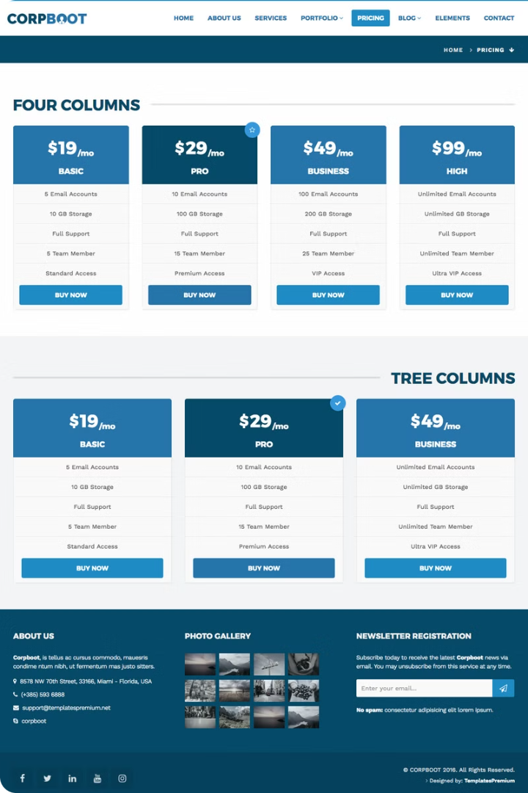
User Story Example 4
As a website administrator, I want to be able to manage user accounts, so that I can ensure data security. This user story is crucial for maintaining the integrity and privacy of the website's information. By having the ability to add, modify, and delete user profiles, the administrator can control access levels and prevent unauthorized access to sensitive data.

Slide 5

User Story Example 5
As a student, I want to be able to access course materials online, so that I can study at my own pace. Having digital access to lecture notes, assignments, and supplementary resources will allow me to review the material as needed and work through it on my own schedule. This flexibility will help me better understand the course content and improve my learning outcomes.

Slide 6
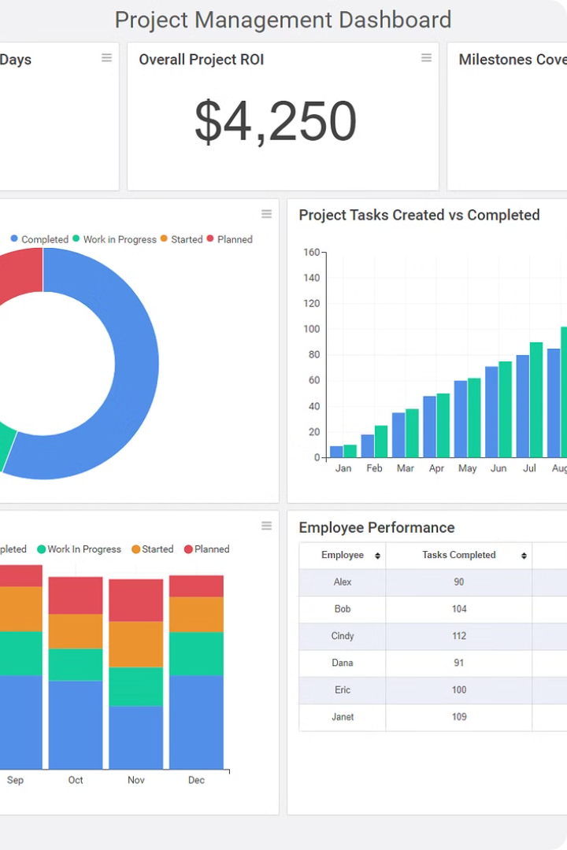
User Story Example 6
As a project manager, I want to be able to track team progress so that I can ensure the project is on schedule. By monitoring the team's tasks, milestones, and overall productivity, I can identify any roadblocks or delays early on and make adjustments to keep the project moving forward. This visibility allows me to provide timely updates to stakeholders and manage expectations effectively.

Slide 7
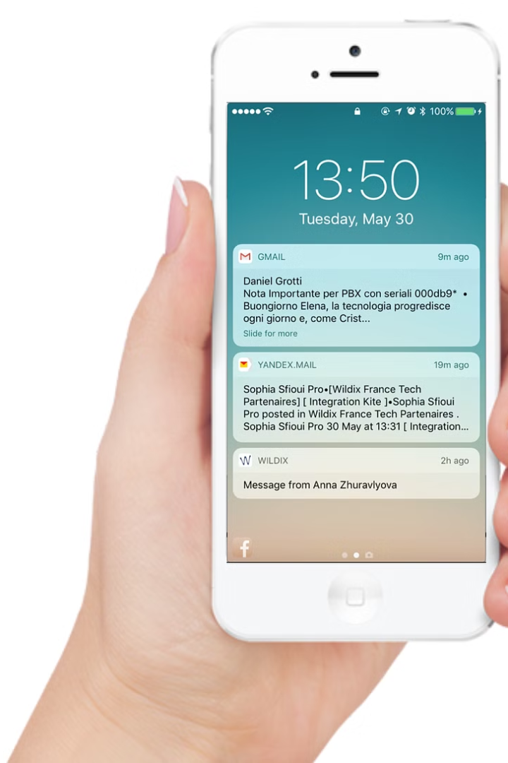
User Story Example 7
As a mobile app user, I want to be able to receive push notifications, so that I can stay informed about important updates and new features. Push notifications allow me to stay engaged with the app even when it's not open, ensuring I don't miss critical information or time-sensitive opportunities.

Slide 8

User Story Example 8
As a healthcare provider, I want to be able to access patient records securely, so that I can provide better care. Patients' medical histories and personal information must be protected to maintain trust and confidentiality. Secure access to this data allows me to make informed decisions about treatment and ensure continuity of care.

Slide 9
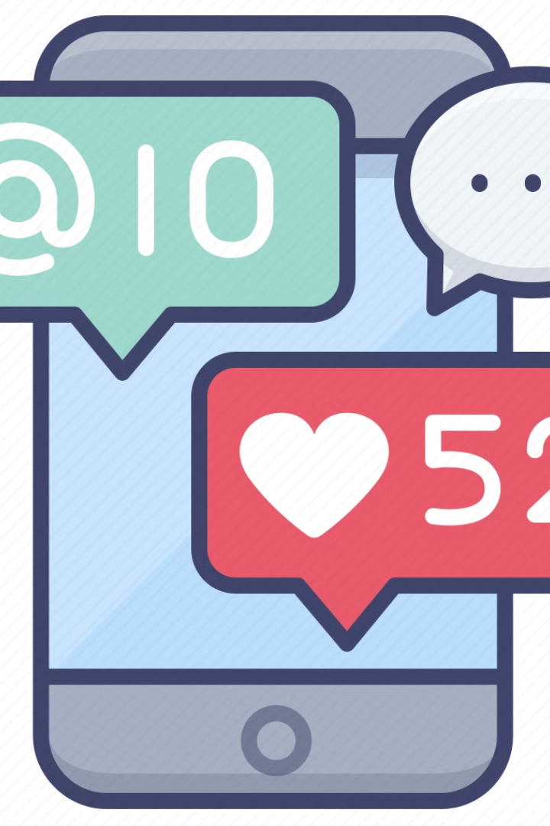
User Story Example 8: Sharing Content on Social Media
As a social media user, being able to share engaging content with your friends and family is crucial for staying connected in the digital age. Sharing photos, videos, links, and updates allows you to showcase your interests, experiences, and thoughts, strengthening the bonds with your online network.

Slide 10

Conclusion and Next Steps
In this presentation, we've explored several compelling user stories that highlight the diverse needs and priorities of our target users. As we move forward, the next steps will be to incorporate this user feedback into our product roadmap and design process.

